Slide 1

Workers Supervision for Construction Safety
PHAM, Trung Kien DO, Van Quyet
Notes:
Welcome back to the presentation for the second half of our project

Slide 2
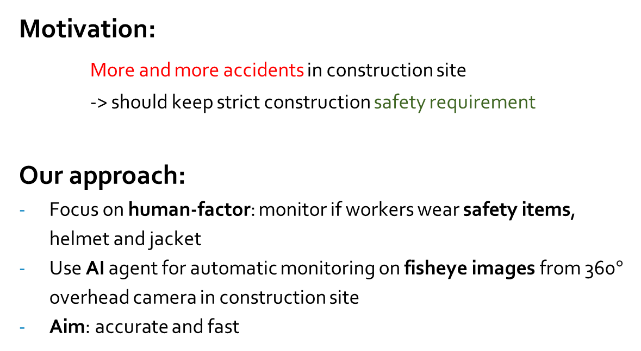
RECAP !
Motivation:
More and more accidents in construction site -> should keep strict construction safety requirement
Our approach:
Focus on human-factor: monitor if workers wear safety items, helmet and jacket
Use AI agent for automatic monitoring on fisheye images from 360$°$ overhead camera in construction site
Aim: accurate and fast
Notes:
A little of RECAP
we only consider the two most common safety items.

Slide 3
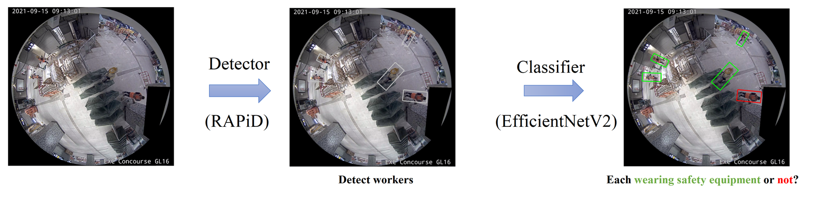
RECAP !
Pipeline
Detect workers on fisheye frames
- Yolo-based, rotated bounding box
- trained on HABBOF and CEPDOF
Classify each as wearing/not all items
- use some methods to accelerate the training process
- dataset is under collecting and processing
Chosen model
Training process
Notes:
We choose them because they fit our aim: they are the SOTA model for the task they performs, as the highest evaluation score and FPS

Slide 4
What is new?
Overview
Objectives
Datasets
Methodology
Experimental Result
Conclusion

Slide 5
2 Objective

Slide 6
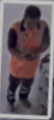
2. Objective
Use one classifier to determine if wearing all each safety equipment
-> one for helmet, one for jacket
EfficientNetV2
Wear helmet or not
Wear jacket or not
EfficientNetV2

Slide 7
2. Objective
Reasons:
Practical application:
more specific alert on the missing item
Data utilization: For each equipment,
Find good sources
Guarantee data balance
Notes:
The second reason is that, as we found good sources of images and could distribute them into 2 separated datasets, each for one equipment, while guarantee the balance of each. I will talk about that in the next part

Slide 8
3 Datasets

Slide 9
3. Datasets
for Classifiers: Extracting + Labeling
crawled standard images
CEPDOF HABBOF
Videos from construction sites
Truth annotation
YOLO v5
Our trained detector
Data pool:
For each, 30k images, ~50:50 wearing/not
labelled according to the source
Helmet
Jacket
Notes:
the target image type is single-person, and there is one dataset for helmet and one for jacket
We collected in two ways:
one is by scraping, crawling, and then cropping from open sources on the internet like Google Images and Shutterstock;
images obtained are in standard rectangle form and they include both people and background, thus we used pretrained YOLOv5 to extract our targeted single-person frames
the other is by cropping from fisheye frames of CEPDOF, HABBOF and videos from construction sites.
We can retrieve human objects from images in CEPDOF and HABBOF datasets by the groundtruth annotation.
Also, we utilized our detector after well-trained to do the extraction on construction-site videos since those are captured in fisheye setting.
Simultaneously, Labelling.
limited human resource -> a little part by hand, the rest use their original source to determine
fisheye: videos -> mostly wear all -> positive examples
CEPDOF, HABBOF: guarantee not wear any of helmet and jacket as recorded in office -> negative examples
standard: based on the keyword search:, e.g images yielded from the search “workers with safety helmet” would almost always contain people wearing safety helmet
, random check, scanning through the data set -> not significant number of mislabels
Finally, we get approximately 30k instances for each equipment, with ratio 50:50 of wearing/not wearing that equipment. This is the balance in data I talked in the previous part.
In each set, there are many instances of each subcases: wear only this item, also wear other items, …; to make sure that the dataset only focus on that specific item.
? Why not combine (4 classes for 1 model): difficulty on annotation

Slide 10
4 Methodology
Notes:
And, in the next part, I would like to introduce an ad-hoc data augmentation

Slide 11
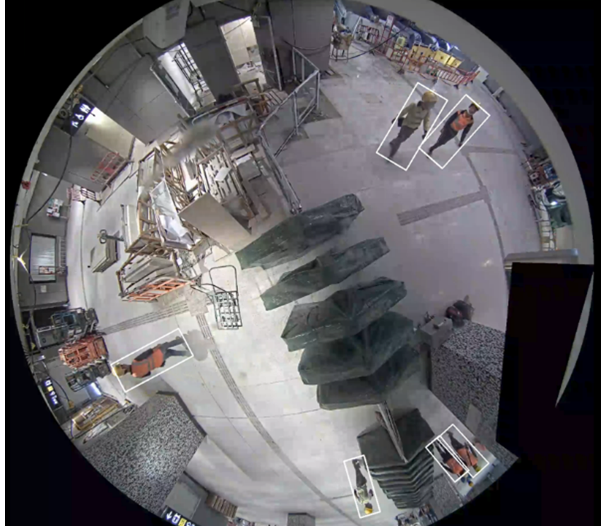
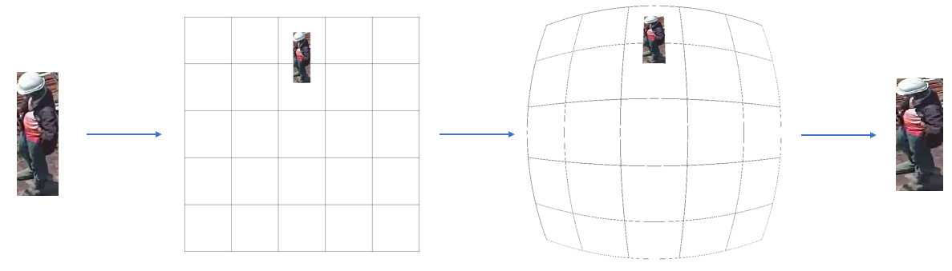
4. Methodology
Data Augmentation: Fisheye distortion Why apply? -> If not, possible out-domain data issue How to apply? -> Simulate the way fisheye cameras capture the scene
Notes:
As suggested by our professor, we examine the effect of Fisheye distortion augmentation to the classifiers.
Recall the reason we apply it, that the characteristics of standard images may be different from those of fisheye images. That probably raises the out-domain issue, in which additional train data are heterogeneous to existing data, thus may not improve or even lower performance of model. To overcome this problem, we consider applying fisheye effect on instances cropped from standard images, as give a certain level of distortion to those instances.
We simulate the way fisheye cameras capture the scene with the focus on a particular object. As shown in the diagram, for each standard instance, we place it to a random-size empty square texture at a random location, then apply fisheye effect on the whole texture while keeping track of the image location as coordinates of four corners, and finally use those information to extract the image back. In this process, the whole texture plays as original scene.
To better understand where to paste standard instances in empty textures, we take a close look at fisheye frame retrieved from onsite camera. In most the cases, worker objects are aligned in radius of the images, with foot-to-head direction pointing out, and they are relatively far from the fisheye images' center. Thus, when we apply fisheye effect, we need to put crawled images in the same setting. Furthermore, because of the symmetry, putting standard instance in any radius will give us the same distorted version of it. Therefore, to simplify our implementation of fisheye effect, we only render standard instance in the upper vertical radius.
We control the distortion by three parameters: distortion coefficient, relative size of instance vs texture, and vertical position

Slide 12
5 Experimental Result

Slide 13
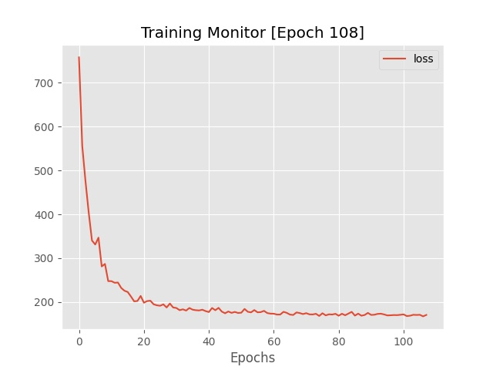
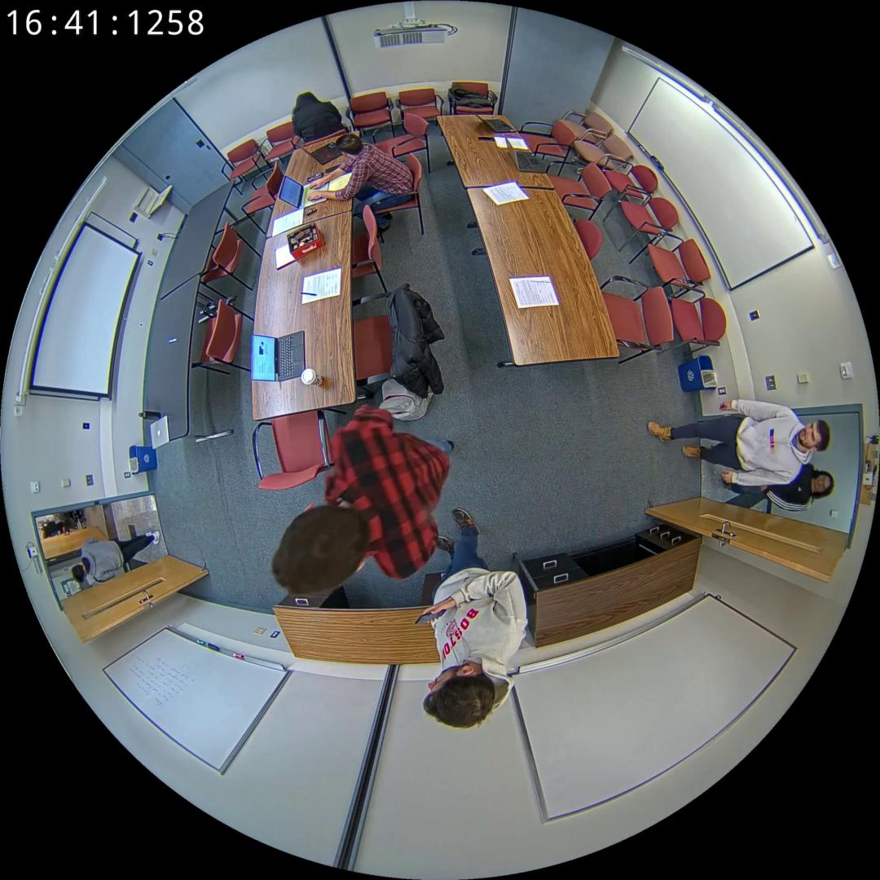
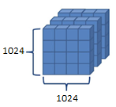

5.1.1 Multi-Person Detector - Preliminary
$$✓$$
RAPiD architecture implementation
Training and Fine-tuning process ~80%
Resize
Normalize
Convert to tensor
Datasets: CEPDOF and HABBOF
Images + Annotations
Preprocessing process
Normalized tensors of
1024x1024 spatial resolution
Loss decreases over epoch
learning rate = 1.e-4
momentum = 0.9
weight decay = 5.e-4
Configuration
batch size = 16
epoch ~ 100 ≈ 200000 iterations
At first glance, detector is correctly implemented and trained
SGD Optimizer
Training hyperparameters

Slide 14


5.1.2 Multi-Person Detector - Final
$$✓$$
RAPiD architecture implementation
Training and Fine-tuning process
$$✓$$
Resize
Normalize
Convert to tensor
Vertical and Horizontal Flip
Rotation
Brightness and Contrast Adjustment
Colour Jitter
Hyperparameters | Tuning Values
Learning Rate | 1.e-4, 1.e-3
Momentum | 0.9, 0.95
Weight Decay | 5.e-4, 5.e-3
Batch Size | 8, 16, 32
70:30 Train:Val Split

Slide 15

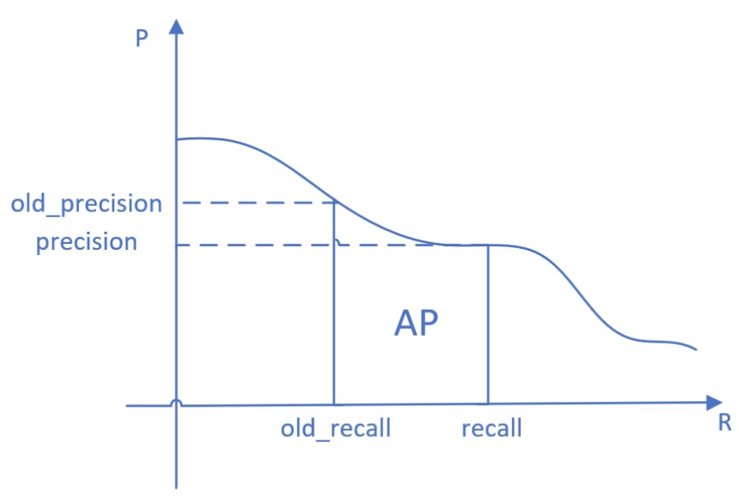
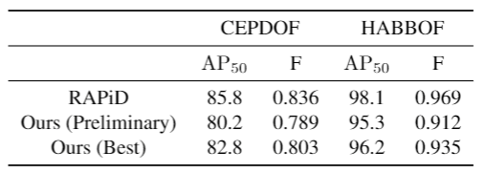
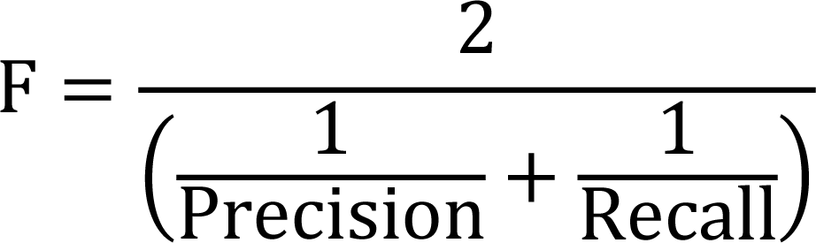
5.1.3 Quantitative Result
Average Precision (AP) at IoU = 0.5 (AP₅₀)
F-measure at a fixed 0.3 confidence threshold

Slide 16
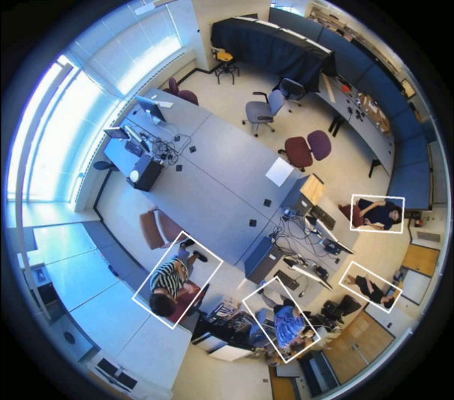
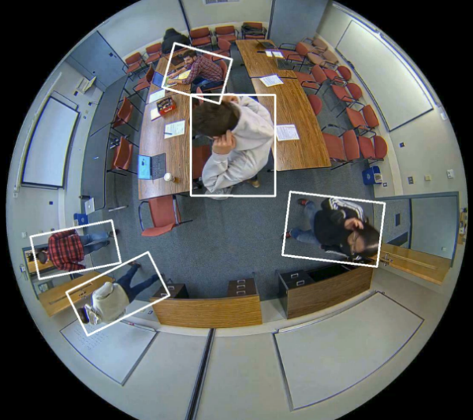
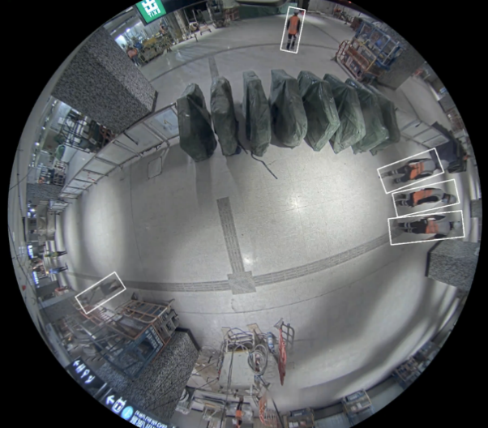
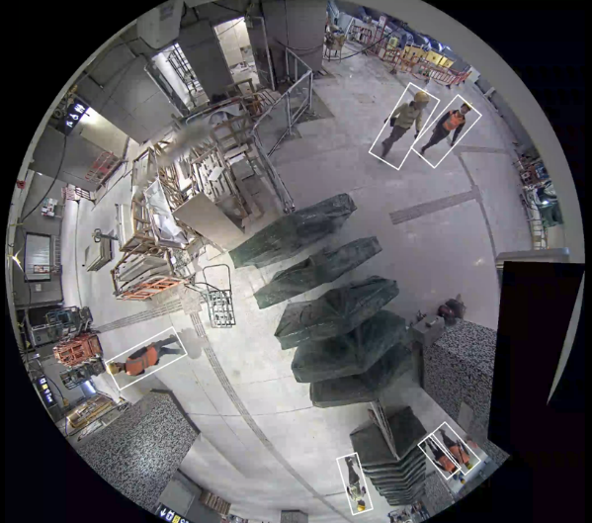
5.1.4 Qualitative Result

Slide 17
5.2.1 Binary Image Classifier - Preliminary
EfficientNetV2 architecture implementation ~80%
Training and Fine-tuning process
Limited resources 0%

Slide 18
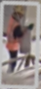
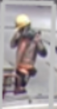
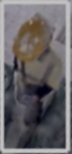


5.2.2 Binary Image Classifier - Final
$$✓$$
EfficientNetV2 architecture implementation
Training and Fine-tuning process
Hyperparameters | Tuning Values
Learning Rate | 1.e-4, 1.e-3
Momentum | 0.9, 0.95
Weight Decay | 5.e-4, 5.e-3
Batch Size | 8, 16, 32
$$✓$$
Resize
Normalize
Convert to tensor
Vertical and
Horizontal Flip
Brightness and
Contrast Adjustment
Colour Jitter
SGD Optimizer
learning rate = 1.e-3
momentum = 0.9
weight decay = 5.e-4
70:30 Train:Val Split
Training Hyperparameters
batch size = 32
epoch ~ 120
≈ 100000 iterations
Fisheye Distortion

Slide 19
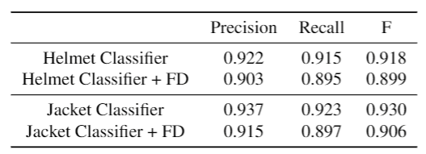
5.2.3 Quantitative Result

Slide 20
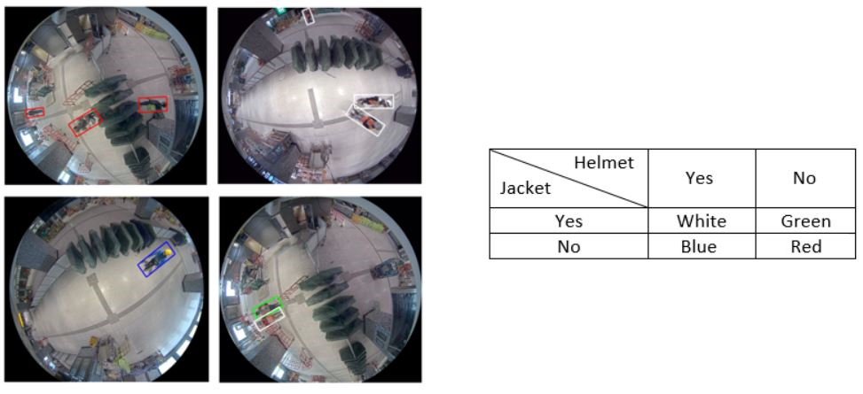
5.2.4 Qualitative Result

Slide 21
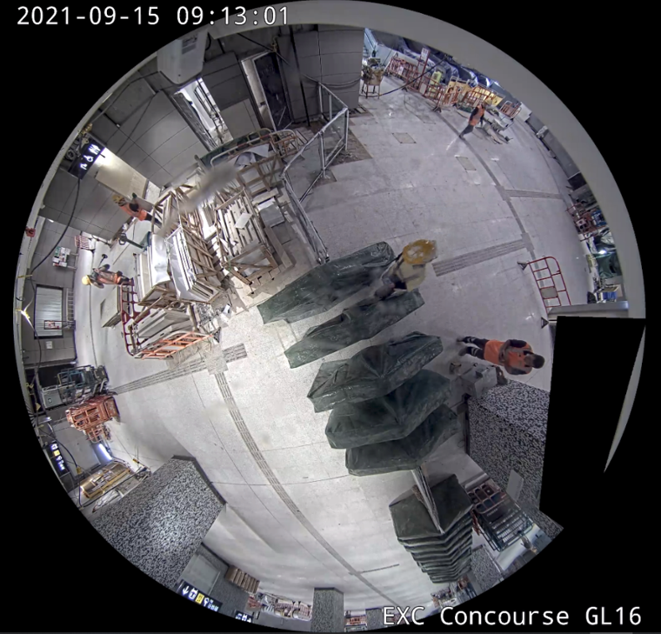
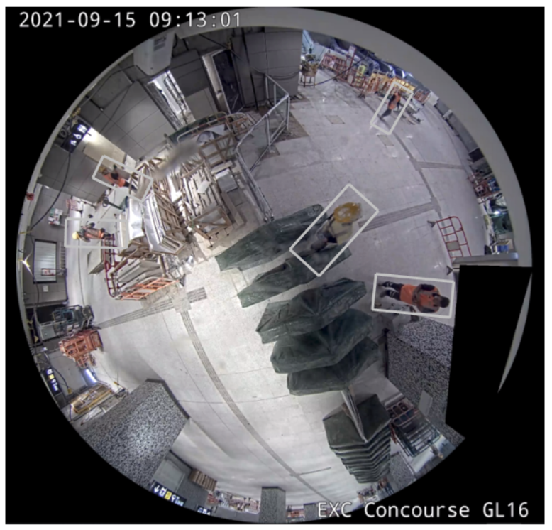
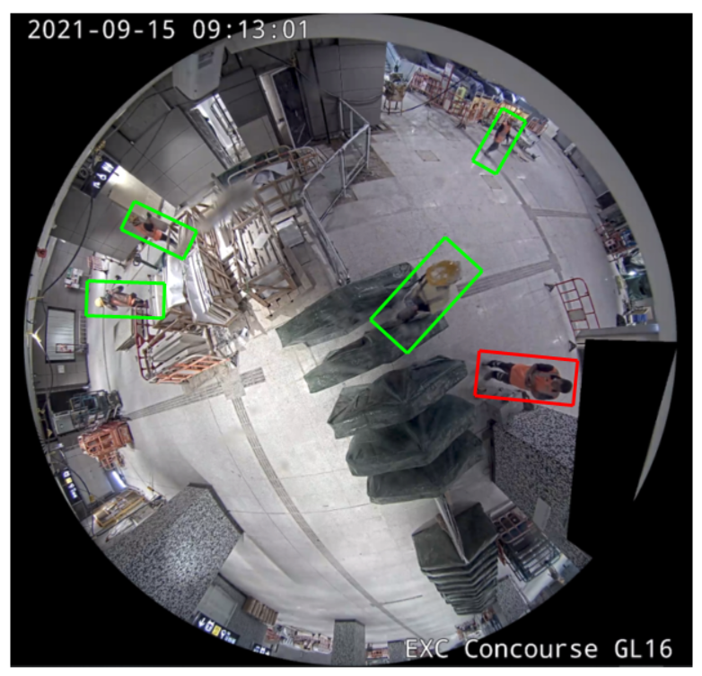
6. Conclusion
Binary Image Classifier
Multi-Person Detector

Slide 22
Thanks for Listening ! Q&A

